Slide 2







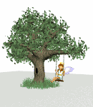




WELCOME TO OUR CLASS
11A1

Slide 3

1
G
U
E
S
T
2
A
N
T
3
G
O
O
G
L
E
4
A
P
P
L
E
5
R
O
U
N
D
6
I
C
E
7
N
O
I
S
E
G
A
G
A
R
I
N

Slide 4
1
WHAT DO YOU CALL SOMEONE WHO IS INVITED TO YOUR HOUSE?

Slide 5
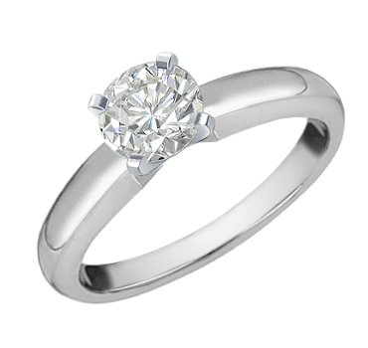
2
WHAT IS THE SHAPE OF THE RING?

Slide 6
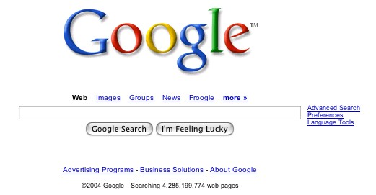
3
THIS IS A VERY WELL-KNOWN WEBSITE.

Slide 7
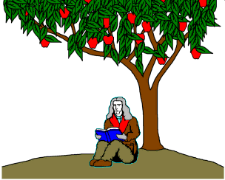
4
WHAT KIND OF FRUIT IS IT?

Slide 8
5
ACCORDING TO THE LEGEND, THIS ANIMAL IS SMALL BUT IT CAN KILL AN ELEPHANT.

Slide 9

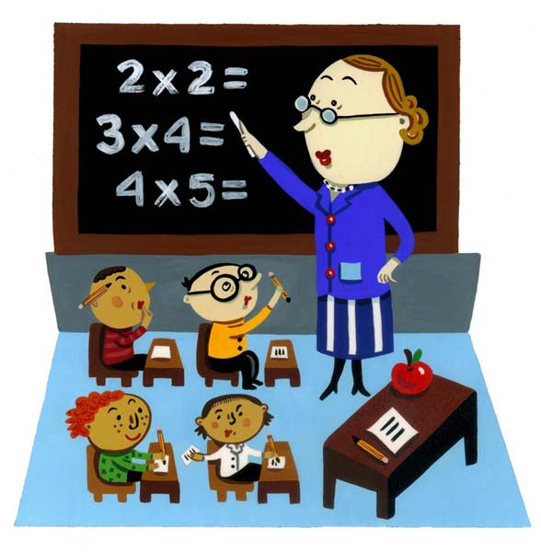
THE STUDENTS MAKE ……….. IN CLASS.
6

Slide 10
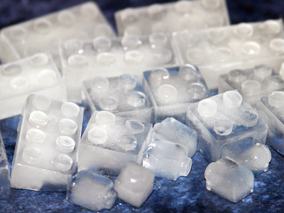
WHAT IS THIS?
7

Slide 11
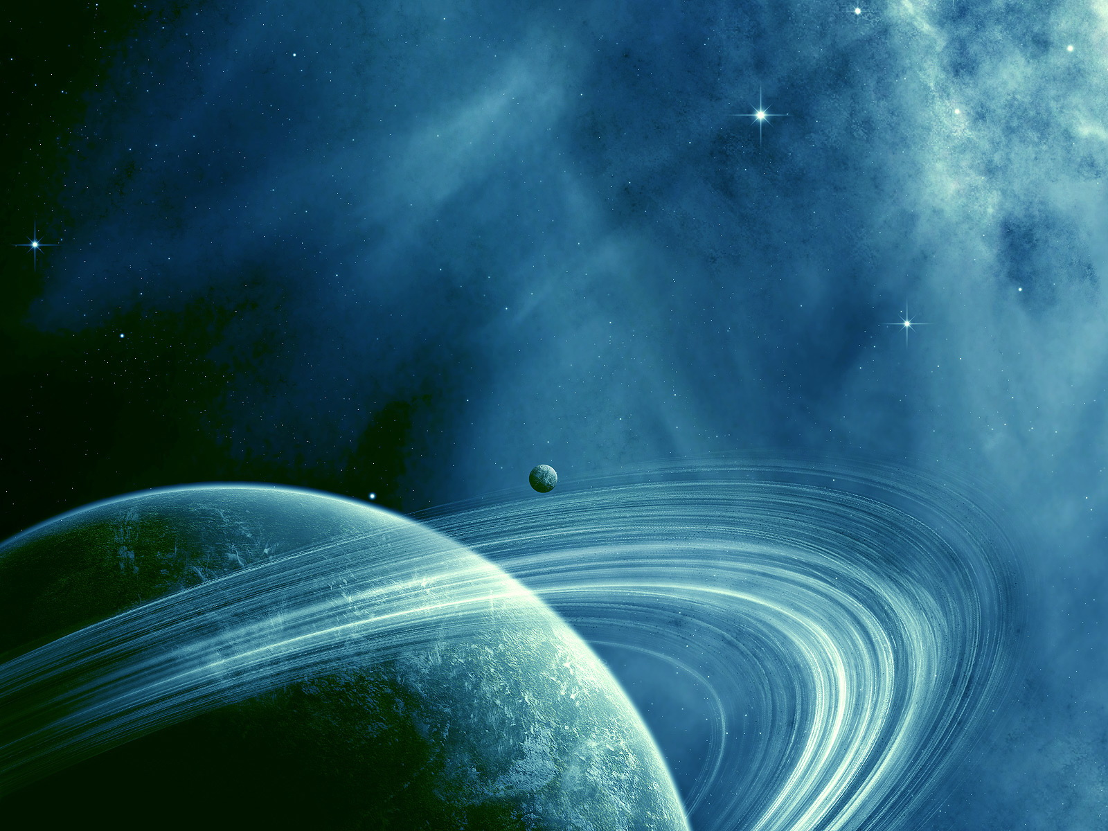
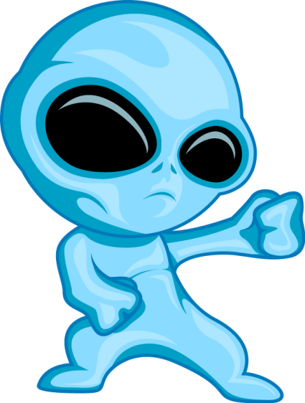
READING
UNIT 15
SPACE CONQUEST

Slide 12

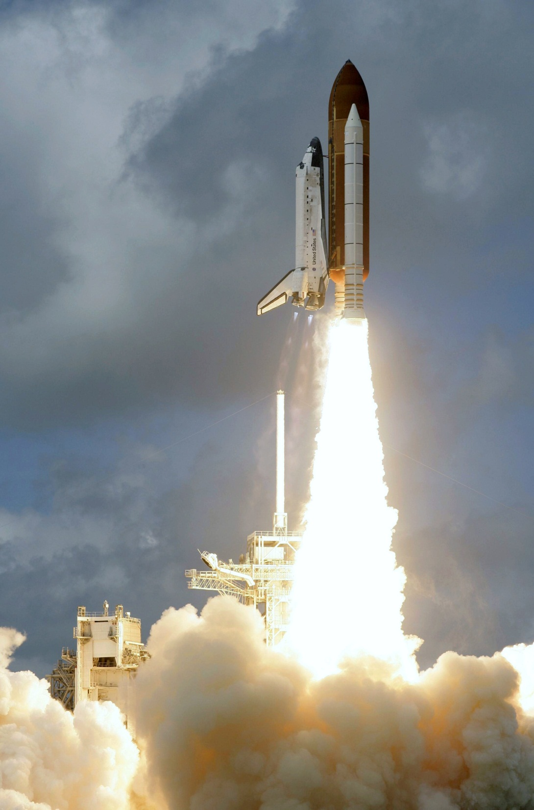

Vocabulary
lift off (v.) /ˈlɪft.ɒf/ : when a spacecraft or rocket leaves the ground

Slide 13
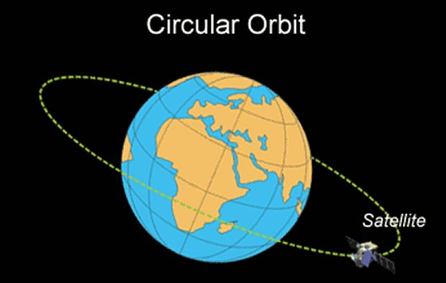
Vocabulary
orbit (n.) /ˈɔːbɪt/ (n.)

Slide 14
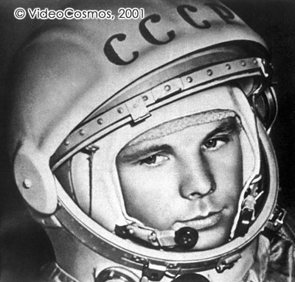
Vocabulary
cosmonaut (n.) /ˈkɒzmənɔːt/ : an astronaut (= person who travels into space) from the country previously called the Soviet Union

Slide 15
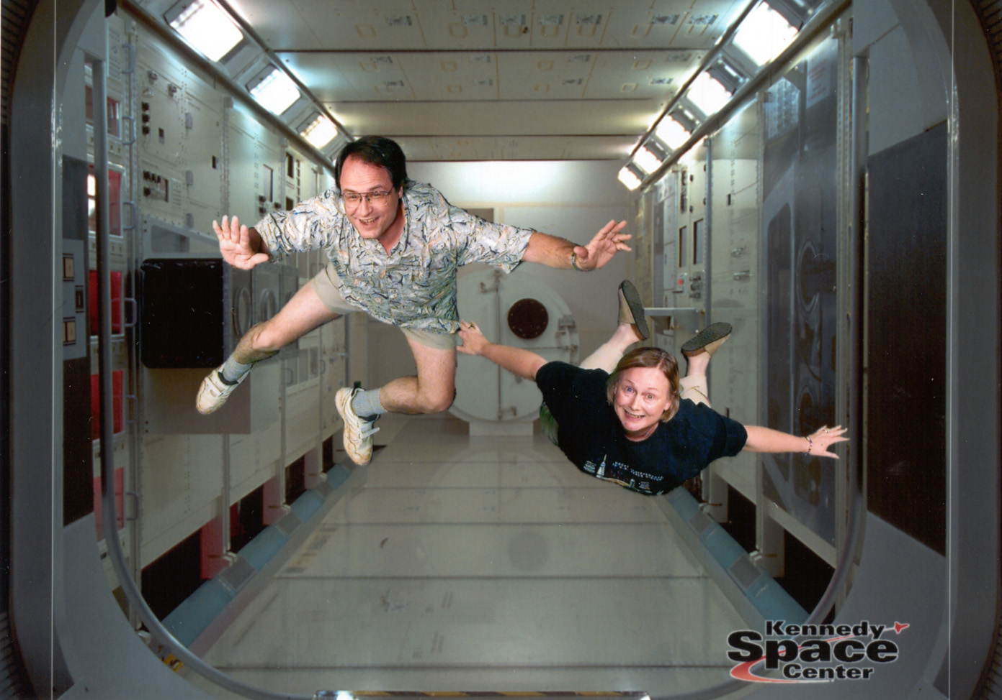

Vocabulary
weight (n.)
weightless (adj.)
weightlessness (n.)
weigh (v.)

Slide 16

Vocabulary
psychology /saɪˈkɒlədʒi/ (n.) :tâm lý
➔ psychological /ˌsaɪkəˈlɒdʒɪkl/ (adj.)
venture /ˈventʃər / (n.)

Slide 17
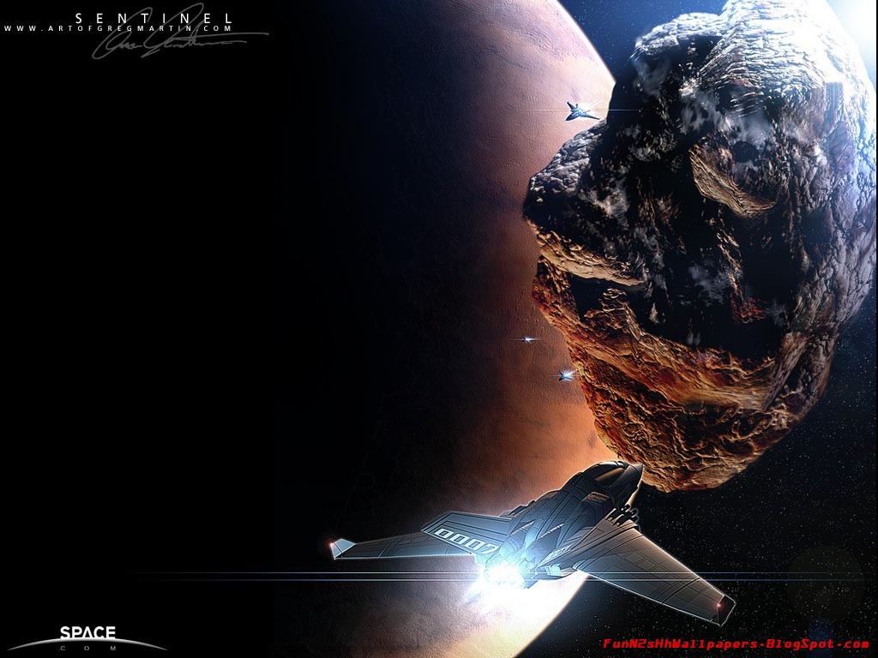
TASK 1
MATCH THE HEADINGS TO THE CORRECT PARAGRAPHS

Slide 18
PARAGRAPH | HEADINGS
PARAGRAPH 1 | A. THE TRAGIC ACCIDENT
PARAGRAPH 2 | B. THE LIFT-OFF
PARAGRAPH 3 | C. CONGRATULATIONS
PARAGRAPH 4 | D. A VIEW ON EARTH
PARAGRAPH 5 | E. UNCERTAINTIES

Slide 19
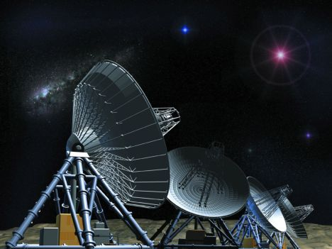
TASK 2
CHOOSE THE CORRECT ANSWERS

Slide 20
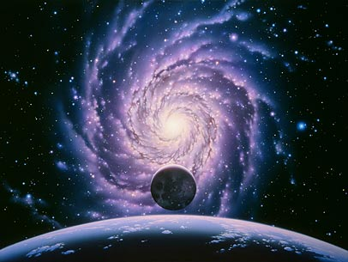
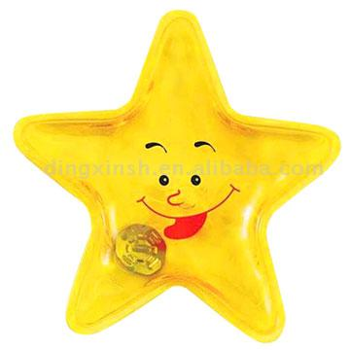


3
5
2
6
4
1

Slide 21

T
Choose the
C
R
R
C
O
E
answers
10
1
2
3
4
5
6
7
8
9
0
1
15
How old was Gagarin when he became the first human being in space?
A. 28
B. 27
C. 26
D. 25

Slide 22
T
Choose the
C
R
R
C
O
E
answers
2
10
1
2
3
4
5
6
7
8
9
0
15
How long was he in space?
A. 108 minutes
B. 109 minutes
C. 120 minutes
D. 150 minutes

Slide 23
T
Choose the
C
R
R
C
O
E
answers
10
1
2
3
4
5
6
7
8
9
3
0
15
Before Gagarin’s historic flight, who knew exactly what would happen to human being in space?
A. scientists
B. Gagarin
C. explorers
D. No body

Slide 24
T
Choose the
C
R
R
C
O
E
answers
Lucky !
10
1
2
3
4
5
6
7
8
9
0
4
15
What was the speed of his space craft in orbit around the Earth?
A. more than 17,000 miles per hour
B. 17,000 miles per hour
C. less than 17,000 miles per hour
D. 18,000 miles per hour

Slide 25
T
Choose the
C
R
R
C
O
E
answers
10
1
2
3
4
5
6
7
8
9
0
15
5
.
Why couldn’t Gagarin make a new space flight?
A. Because he is too old.
B. Because he is too tired.
C. Because there is a new astronaut for the flight.
D. Because he died in a plane crash.

Slide 26
T
Choose the
C
R
R
C
O
E
answers
10
1
2
3
4
5
6
7
8
9
0
6
15
Choose two events that were done after Gagarin’s death to honour Gagarin?
A. His hometown was renamed
B. His funeral lasted for 3 days.
C. His house was rebuilt as a historical site.
D. The Cosmonaut Training Center was named after him.

Slide 27
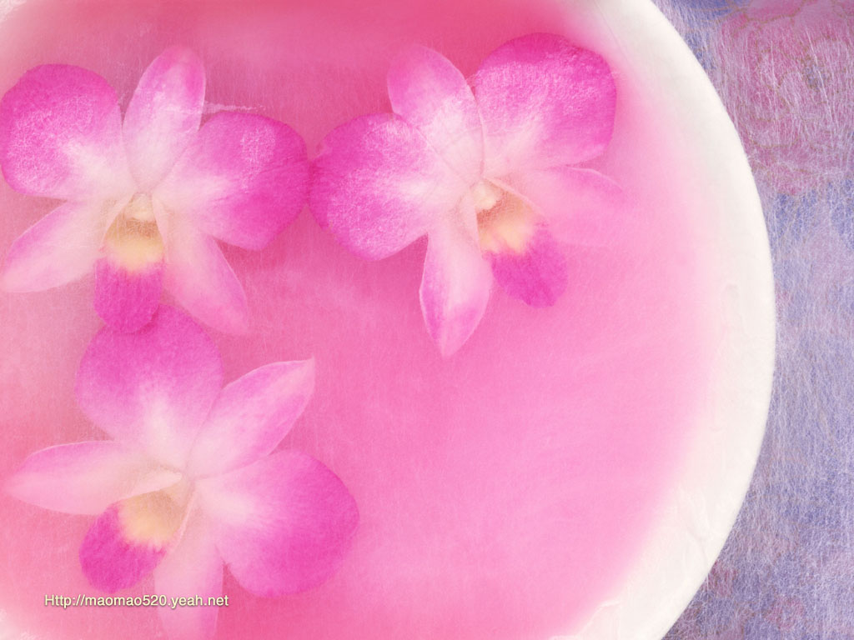
Task 3:
Complete the summary with the information from the passage.

Slide 28
impossible named after lasted gravity success view in space cosmonaut
On 12th April,1961, Yuri Gagarin, A Russian (1)________ became the first human being (2) ______. Although his flight (3) ______ only 108 minutes, its (4) _______ made him a national hero. He also became the first person to eat and drink in zero (5) _______ and he was able to (6) _____ the Earth in away that no one had done before. Unfortunately, a plane crash in March 1968 made Gagarin’s desire of revisiting space (7) ________ . After his death, his hometown and the Cosmonaut Training Centre at Star City, Russia were (8)_________ him.
in space
cosmonaut
lasted
success
gravity
view
impossible
named after

Slide 29

Thank you for
your attention

